Slide 1
Monopoly
A competitive firm takes the price of its output as given by the market and then chooses the quantity it will supply so that price equals marginal cost. By contrast, a monopoly charges a price that exceeds marginal cost. This result is clearly true in the case of Microsoft’s Windows. The marginal cost of Windows—the extra cost that Microsoft incurs by printing one more copy of the program onto a CD—is only a few dollars. The market price of Windows is many times its marginal cost.
As we examine the production and pricing decisions of monopolies, we also consider the implications of monopoly for society as a whole. Monopoly firms, like competitive firms, aim to maximize profit. But this goal has very different ramifications for competitive and monopoly firms. In competitive markets, self-interested consumers and producers behave as if they are guided by an invisible hand to promote general economic well-being. By contrast, because monopoly firms are unchecked by competition, the outcome in a market with a monopoly is often not in the best interest of society.

Slide 2
What governments can do to control monopolies?
governments can sometimes improve market outcomes. The analysis in this chapter sheds more light on this principle. As we examine the problems that monopolies raise for society, we discuss the various ways in which government policymakers might respond to these problems. The U.S. government, for example, keeps a close eye on Microsoft’s business decisions. In 1994, it blocked Microsoft from buying Intuit, a leading seller of personal finance software, on the grounds that combining the two firms would concentrate too much market power. Similarly, in 1998, the U.S. Department of Justice objected when Microsoft started integrating its Internet browser into its Windows operating system, claiming that this addition would extend the firm’s market power into new areas. To this day, Microsoft continues to wrangle with antitrust regulators in the United States and abroad.

Slide 3
Why monopolies arise?
A firm is a monopoly if it is the sole seller of its product and if its product does not have close substitutes. The fundamental cause of monopoly is barriers to entry: A monopoly remains the only seller in its market because other firms cannot enter the market and compete with it. Barriers to entry, in turn, have three main sources:
Monopoly resources: A key resource required for production is owned by a single firm.
Government regulation: The government gives a single firm the exclusive right to produce some good or service.
The production process: A single firm can produce output at a lower cost than can a larger number of producers.

Slide 4
Government-Created Monopolies
In many cases, monopolies arise because the government has given one person or firm the exclusive right to sell some good or service. Sometimes the monopoly arises from the sheer political clout of the would-be monopolist. Kings, for example, once granted exclusive business licenses to their friends and allies. At other times, the government grants a monopoly because doing so is viewed to be in the public interest. For example: WASA. DESCO
The effects of patent and copyright laws are easy to see. Because these laws give one producer a monopoly, they lead to higher prices than would occur under competition. But by allowing these monopoly producers to charge higher prices and earn higher profits, the laws also encourage some desirable behavior.

Slide 5
Natural Monopolies
An industry is a natural monopoly when a single firm can supply a good or service to an entire market at a lower cost than could two or more firms. A natural monopoly arises when there are economies of scale over the relevant range of output. Figure 1 shows the average total costs of a firm with economies of scale. In this case, a single firm can produce any amount of output at least cost. That is, for any given amount of output, a larger number of firms leads to less output per firm and higher average total cost. An example of a natural monopoly is the distribution of water. To provide water to residents of a town, a firm must build a network of pipes throughout the town. If two or more firms were to compete in the provision of this service, each firm would have to pay the fixed cost of building a network. Thus, the average total cost of water is lowest if a single firm serves the entire market.

Slide 6
Natural Monopolies
When a firm is a natural monopoly, it is less concerned about new entrants eroding its monopoly power. Normally, a firm has trouble maintaining a monopoly position without ownership of a key resource or protection from the government. The monopolist’s profit attracts entrants into the market, and these entrants make the market more competitive. By contrast, entering a market in which another firm has a natural monopoly is unattractive. Would-be entrants know that they cannot achieve the same low costs that the monopolist enjoys because, after entry, each firm would have a smaller piece of the market. In some cases, the size of the market is one determinant of whether an industry is a natural monopoly. Again, consider a bridge across a river. When the population is small, the bridge may be a natural monopoly. A single bridge can satisfy the entire demand for trips across the river at lowest cost. Yet as the population grows and the bridge becomes congested, satisfying the entire demand may require two or more bridges across the same river. Thus, as a market expands, a natural monopoly can evolve into a more competitive market.

Slide 7
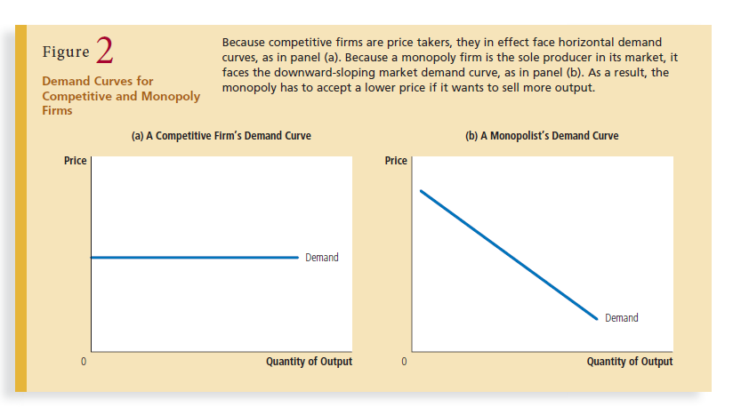

Slide 8
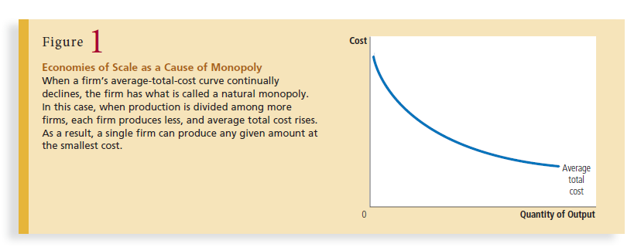

Slide 9
What determines revenue and cost of a monopoly?
In particular, the market demand curve describes the combinations of price and quantity that are available to a monopoly firm. By adjusting the quantity produced (or equivalently, the price charged), the monopolist can choose any point on the demand curve, but it can not choose a point off the demand curve.
What price and quantity of output will the monopolist choose? As with competitive firms, we assume that the monopolist’s goal is to maximize profit. Because the firm’s profit is total revenue minus total costs, our next task in explaining monopoly behavior is to examine a monopolist’s revenue.

Slide 10
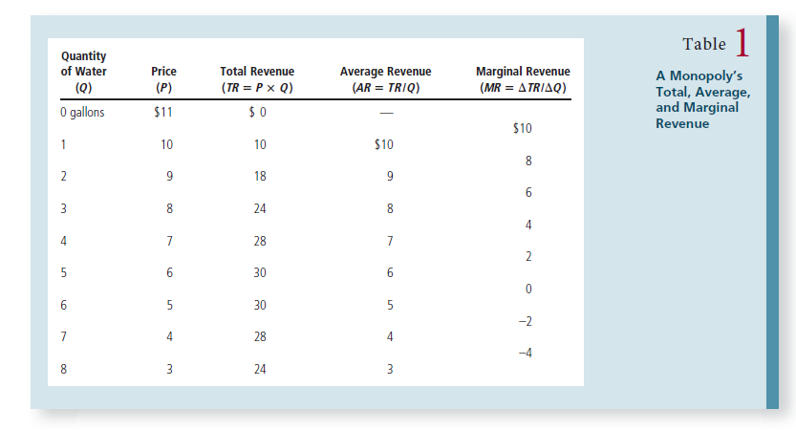

Slide 11
Table 1 shows a result that is important for understanding monopoly behavior: A monopolist’s marginal revenue is always less than the price of its good. For example, if the firm raises production of water from 3 to 4 gallons, it will increase total revenue by only $4, even though it will be able to sell each gallon for $7. For a monopoly, marginal revenue is lower than price because a monopoly faces a downward-sloping demand curve. To increase the amount sold, a monopoly firm must lower the price it charges to all customers. Hence, to sell the fourth gallon of water, the monopolist will get $1 less revenue for each of the first three gallons. This $3 loss accounts for the difference between the price of the fourth gallon ($7) and the marginal revenue of that fourth gallon ($4).

Slide 12
Some points to consider in the table
As the figure illustrates, total revenue for a monopolist rises, flattens out, and then falls. In this example, total revenue is highest at a quantity 5 or 6. BUT WHY?
Clearly, the total revenue for a monopolist is not a straight upward-sloping line, in the way that total revenue was for a perfectly competitive firm. The different total revenue pattern for a monopolist occurs because the quantity that a monopolist chooses to produce affects the market price, which was not true for a perfectly competitive firm. If the monopolist charges a very high price, then quantity demanded drops, and so total revenue is very low. If the monopolist charges a very low price, then, even if quantity demanded is very high, total revenue will not add up to much.

Slide 13
Some points to consider in the table
However, the monopolist is not seeking to maximize revenue, but instead to earn the highest possible profit.
A monopolist can use information on marginal revenue and marginal cost to seek out the profit-maximizing combination of quantity and price.
This monopoly faces a typical upward-sloping marginal cost curve,

Slide 14
Some points to consider in the table
Notice that marginal revenue is zero at a quantity of 6 and turns negative at quantities higher than 6. It may seem unrealistic in a sense that MR can be negative or zero. after all, does an increase in quantity sold not always mean more revenue?
For a perfect competitor, each additional unit sold brought a positive marginal revenue, because marginal revenue was equal to the given market price. But a monopolist can sell a larger quantity and see a decline in total revenue. When a monopolist increases sales by one unit, it gains some marginal revenue from selling that extra unit, but also loses some marginal revenue because every other unit must now be sold at a lower price. As the quantity sold becomes higher, the drop in price affects a greater quantity of sales, eventually causing a situation where more sales cause marginal revenue to be negative.

Slide 15
Some points to consider in the table
A monopolist can determine its profit-maximizing price and quantity by analyzing the marginal revenue and marginal costs of producing an extra unit. If the marginal revenue exceeds the marginal cost, then the firm should produce the extra unit.
A monopoly will produce (meaning will set up quantity) at MC = MR (profit maximizing level)
The key difference with a perfectly competitive firm is that in the case of perfect competition, marginal revenue is equal to price (MR = P), while for a monopolist, marginal revenue is not equal to the price, because changes in quantity of output affect the price.

Slide 16
Monopoly’s total revenue
Marginal revenue for monopolies is very different from marginal revenue for competitive firms. When a monopoly increases the amount it sells, this action has two effects on total revenue (P x Q):
The output effect: More output is sold, so Q is higher, which tends to increase total revenue.
The price effect: The price falls, so P is lower, which tends to decrease total revenue.

Slide 17
Because a competitive firm can sell all it wants at the market price, there is no price effect.
When it increases production by 1 unit, it receives the market price for that unit, and it does not receive any less for the units it was already selling. That is, because the competitive firm is a price taker, its marginal revenue equals the price of its good.
By contrast, when a monopoly increases production by 1 unit, it must reduce the price it charges for every unit it sells, and this cut in price reduces revenue on the units it was already selling. As a result, a monopoly’s marginal revenue is less than its price.

Slide 18
For a monopoly there is a price effect. It must reduce price to sell additional output. So the marginal revenue on its additional unit sold is lower than the price, because it gets less revenue for previous units as well (it has to reduce price to the same amount for all units)
While marginal revenue is the same as price for a competitive firm, it is less than price for a monopolist.A competitive wheat farmer will take the price of wheat as given by the market at (say) $5 a bushel. Sellinganother bushel of wheat brings the farmer amarginal revenue of another $5.
The monopolist does not take the price of his product as given. Indeed, he knows that in order to sell more he will have to REDUCE the price of his product. In our introductory model of monopoly, we assume that the monopolist cannot price discriminate ; that is, that he must sell all output at the same price.

Slide 19
Figure 3 graphs the demand curve and the marginal-revenue curve for a monopoly firm. (Because the firm’s price equals its average revenue, the demand curve is also the average-revenue curve.) These two curves always start at the same point on the vertical axis because the marginal revenue of the first unit sold equals the price of the good. But for the reason we just discussed, the monopolist’s marginal revenue on all units after the first is less than the price of the good. Thus, a monopoly’s marginal-revenue curve lies below its demand curve. You can see in the figure (as well as in Table 1) that marginal revenue can even become negative. Marginal revenue is negative when the price effect on revenue is greater than the output effect. In this case, when the firm produces an extra unit of output, the price falls by enough to cause the firm’s total revenue to decline, even though the firm is selling more units.

Slide 20
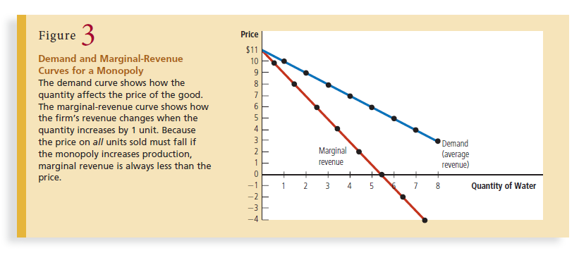

Slide 21
Profit Maximization
Now that we have considered the revenue of a monopoly firm, we are ready to examine how such a firm maximizes profit. Recall from Chapter 1 that one of the Principles of Economics is that rational people think at the margin. This lesson is as true for monopolists as it is for competitive firms. Here we apply the logic of marginal analysis to the monopolist’s decision about how much to produce. Figure 4 graphs the demand curve, the marginal-revenue curve, and the cost curves for a monopoly firm. All these curves should seem familiar: The demand and marginal-revenue curves are like those in Figure 3, and the cost curves are like those we encountered in the last two chapters. These curves contain all the

Slide 22
information we need to determine the level of output that a profit-maximizing monopolist will choose. Suppose, first, that the firm is producing at a low level of output, such as Q1. In this case, marginal cost is less than marginal revenue. If the firm increased production by 1 unit, the additional revenue would exceed the additional costs, and profit would rise. Thus, when marginal cost is less than marginal revenue, the firm can increase profit by producing more units.

Slide 23
A similar argument applies at high levels of output, such as Q2. In this case, marginal cost is greater than marginal revenue. If the firm reduced production by 1 unit, the costs saved would exceed the revenue lost. Thus, if marginal cost is greater than marginal revenue, the firm can raise profit by reducing production. In the end, the firm adjusts its level of production until the quantity reaches QMAX, at which marginal revenue equals marginal cost. Thus, the monopolist’s profit maximizing quantity of output is determined by the intersection of the marginal-revenue curve and the marginal-cost curve. In Figure 4, this intersection occurs at point A. you might recall from the previous chapter that competitive firms also choose the quantity of output at which marginal revenue equals marginal cost. In following this rule for profit maximization, competitive firms and monopolies are alike.

Slide 24
But there is also an important difference between these types of firms: The marginal revenue of a competitive firm equals its price, whereas the marginal revenue of a monopoly is less than its price. That is,
For a competitive firm: P = MR = MC.
For a monopoly firm: P > MR = MC.
The equality of marginal revenue and marginal cost determines the profit maximizing quantity for both types of firm. What differs is how the price is related to marginal revenue and marginal cost.

Slide 25
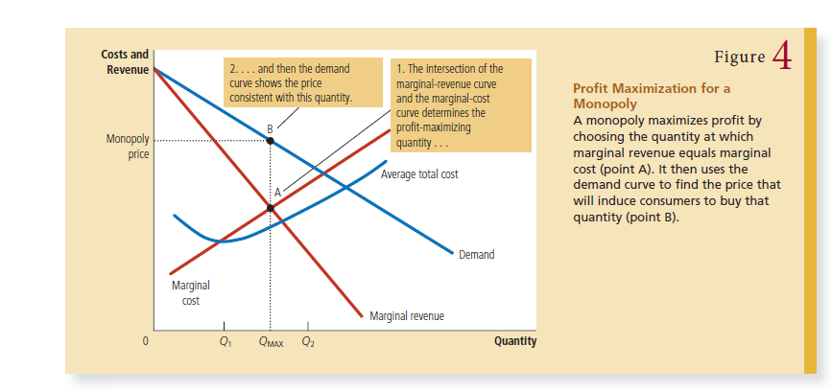

Slide 26
How does the monopoly find the profit-maximizing price for its product?
The demand curve answers this question because the demand curve relates the amount that customers are willing to pay to the quantity sold. Thus, after the monopoly firm chooses the quantity of output that equates marginal revenue and marginal cost, it uses the demand curve to find the highest price it can charge for that quantity. In Figure 4, the profit-maximizing price is found at point B. We can now see a key difference between markets with competitive firms and markets with a monopoly firm: In competitive markets, price equals marginal cost. In monopolized markets, price exceeds marginal cost. As we will see in a moment, this finding is crucial to understanding the social cost of monopoly.

Slide 27
A Monopoly’s Profit
To see a monopoly firm’s profit in a graph, recall that profit equals total revenue (TR) minus total costs (TC):
Profit = TR – TC
We can rewrite this as
Profit = (TR/Q – TC/Q) x Q
TR/Q is average revenue, which equals the price, P, and TC/Q is average total cost, ATC. Therefore, Profit = (P – ATC) x Q

Slide 28
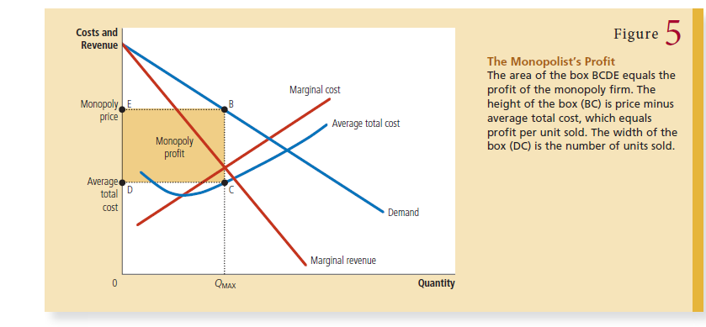

Slide 29
A Monopoly’s Profit
This equation for profit (which also holds for competitive firms) allows us to measure the monopolist’s profit in our graph. Consider the shaded box in Figure 5. The height of the box (the segment BC) is price minus average total cost, P – ATC, which is the profit on the typical unit sold. The width of the box (the segment DC) is the quantity sold, QMAX. Therefore, the area of this box is the monopoly firm’s total profit.

Slide 30
